Slide 1
PERT/CPM

Slide 2
Key Terms
  Critical Path: The longest time path through the task network. The series of tasks (or even a single task) that dictates the calculated finish date of the project (That is, when the last task in the critical path is completed, the project is completed) The "longest" path (in terms of time) to the completion of a project. If shortened, it would shorten the time it takes to complete the project. Activities off the critical path would not affect completion time even if they were done more quickly.

Slide 3
Slack Time
  The amount of time a task can be delayed before the project finish date is delayed. Total slack can be positive or negative. If total slack is a positive it indicates the amount of time that the task can be delayed without delaying the project finish date. If negative, it indicates the amount of time that must be saved so that the project finish date is not delayed. Total Slack = Latest Start - Earliest Start. By default and by definition, a task with 0 slack is considered a critical task. If a critical task is delayed, the project finish date is also delayed. (Also known as float time)

Slide 4
Crashing
  Shifting resources to reduce slack time so the critical path is as short as possible. Always raises project costs and is typically disruptive – a project should be crashed with caution.

Slide 5
Gantt Chart: A bar chart. While visually appealing on a task/duration basis, it is limited because it does not show task or resource relationships well. Strength: easy to maintain and read.
Network Diagram: A wire diagram, Also known as a PERT network diagram. A diagram that shows tasks and their relationships. Limited because it shows only task relationships. Strength: easy to read task relationships.

Slide 6
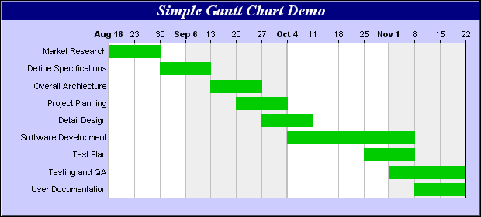
Sample Gantt Chart

Slide 7
Dependencies
Links between project tasks. There are 3 types of dependencies:
  Causal, where 1 task must be completed before another can begin (have to bake bread before you can make a sandwich)
        critical path schedules are based only on causal dependencies
  Resource, where a task is limited by availability of resources (more bread can be baked by 2 bakers, but only 1 is available)
  Discretionary, optional task sequence preferences that, though not required, may reflect organizational preferences

Slide 8
Dummy activity
An imaginary activity with no duration, used to show either an indirect relationship between 2 tasks or to clarify the identities of the tasks . In CPM, each activity must be uniquely defined by its beginning and ending point. When two activities begin and end at the same time, a dummy activity (an activity which begins and ends at the same time) is inserted into the model to distinguish the two activities.

Slide 9
Milestone
A significant task which represents a key accomplishment within the project. Typically requires special attention and control.

Slide 10
Work Breakdown Structure (WBS)
A detailed, hierarchical (from general to specific) tree structure of deliverables and tasks that need to be performed to complete a project.
Purpose: to identify actual tasks to be done in a project. Serves as basis for project planning.
An extension to PERT.

Slide 11
Work Breakdown Structure
Identify the major task categories
Identify sub-tasks, and sub-sub-tasks
Use verb-noun to imply action to something
  Example: Getting up in the morning
    Hit snooze button
    Hit snooze button again
    Get outa bed
    Avoid dog
    Go to bathroom…

Slide 12
Create WBS
Decomposition of project deliverables and activities into smaller, more manageable parts
The lowest level in WBS is a Work Package based on Statement Of Work (SOW)
Needs to be S.M.A.R.T (Specific, Measurable, Attainable, Realistic, Timely)

Slide 14
Work Breakdown Structure
Canoe Trip to
Boundary Waters
Arrange Travel
Get Equipment
Plan Meals
Prepare Budget
Plan for
Emergencies
Plan Activities
Schedule Flights to Mpls
Contact BW Outfitter
Bring cooking gear
Assign Budget Person
Obtain
emerg. #’s
Bring Cards
Rent Van
Rent canoes
Freeze dry food
Get deposits
Arrange
contact at BW
Bring
Joke book
Arrange Motel
Rent Tents
Prepare 7
breakfasts
Retain Receipts
Bring
emerg. flares
Bring scotch
Schedule return flights
Bring
Sleeping Bags
Prepare 7 lunches
Pay for supplies
Bring two
first aid kits
Bring
Fishing Gear
Prepare 6 dinners
Close-out trip
Bring lights and
waterproof
matches

Slide 15
Work Breakdown Structure
Canoe Trip to
Boundary Waters
Arrange Travel
Get Equipment
Plan Meals
Prepare Budget
Plan for
Emergencies
Plan Activities
Schedule Flights to Mpls
Contact BW Outfitter
Bring cooking gear
Assign Budget Person
Obtain
emerg. #’s
Bring Cards
Rent Van
Rent canoes
Freeze dry food
Get deposits
Arrange
contact at BW
Bring
Joke book
Arrange Motel
Rent Tents
Prepare 7
breakfasts
Retain Receipts
Bring
emerg. flares
Bring scotch
Schedule return flights
Bring
Sleeping Bags
Prepare 7 lunches
Pay for supplies
Bring two
first aid kits
Bring
Fishing Gear
Prepare 6 dinners
Close-out trip
Bring lights and
waterproof
matches

Slide 16
Work Breakdown Structure
Canoe Trip to
Boundary Waters
Arrange Travel
Get Equipment
Plan Meals
Prepare Budget
Plan for
Emergencies
Plan Activities
Schedule Flights to Mpls
Contact BW Outfitter
Bring cooking gear
Assign Budget Person
Obtain
emerg. #’s
Bring Cards
Rent Van
Rent canoes
Freeze dry food
Get deposits
Arrange
contact at BW
Bring
Joke book
Arrange Motel
Rent Tents
Prepare 7
breakfasts
Retain Receipts
Bring
emerg. flares
Bring scotch
Schedule return flights
Bring
Sleeping Bags
Prepare 7 lunches
Pay for supplies
Bring two
first aid kits
Bring
Fishing Gear
Prepare 6 dinners
Close-out trip
Bring lights and
waterproof
matches

Slide 17
Work Breakdown Structure
Canoe Trip to
Boundary Waters
Arrange Travel
Get Equipment
Plan Meals
Prepare Budget
Plan for
Emergencies
Plan Activities
Schedule Flights to Mpls
Contact BW Outfitter
Bring cooking gear
Assign Budget Person
Obtain
emerg. #’s
Bring Cards
Rent Van
Rent canoes
Freeze dry food
Get deposits
Arrange
contact at BW
Bring
Joke book
Arrange Motel
Rent Tents
Prepare 7
breakfasts
Retain Receipts
Bring
emerg. flares
Bring scotch
Schedule return flights
Bring
Sleeping Bags
Prepare 7 lunches
Pay for supplies
Bring two
first aid kits
Bring
Fishing Gear
Prepare 6 dinners
Close-out trip
Bring lights and
waterproof
matches

Slide 18
Work Breakdown Structure
System Hardware Replacement
RFP Development
Vendor Selection
Staff Training
Hardware Implementation
Needs Assessment
Research Vendors
Identify training Plan
Schedule Installation
Needs Analysis
Research Sites
Schedule Training
Prepare Site
Write RFP
Select Vendors to mail RFP
Train
Arrange Vendor Support
Finalize with Purchasing
Review Proposals
Configure System
Rank Proposals
Install System
Recommendation

Slide 19
Work Breakdown Structure
System Hardware Replacement
RFP Development
Vendor Selection
Staff Training
Hardware Implementation
Assess Needs
Research Vendors
Identify training Plan
Schedule Installation
Analyze Needs
Research Sites
Schedule Training
Prepare Site
Write RFP
Select Vendors to mail RFP
Train Sysadmins
Arrange Vendor Support
Finalize with Purchasing
Review Proposals
Configure System
Rank Proposals
Install System
Make Recommendations

Slide 20
Work Breakdown Structure
Requires structured brainstorming

Slide 21
WBS Dictionary
A companion document to the WBS
May have detailed content of the components contained in a WBS, including work packages and control accounts
For each WBS component, the WBS dictionary includes a code of account identifier, a statement of work, responsible organization, and a list of schedule milestones
Can include a list of associated schedule activities, resources required, and an estimate of cost
Each WBS component is cross-referenced, as appropriate, to other WBS components

Slide 22
Project Management Assumptions
PM makes several key assumptions
  All tasks have distinct begin and end points
  All estimates can be mathematically derived
  Tasks must be able to be arranged in a defined sequence that produces a pre-defined result
  Resources may be shifted to meet need
  Cost and time share a direct relationship (Cost of each activity is evenly spread over time)
  Time, of itself, has no value
These assumptions make PM controversial

Slide 23
THE PM Concept Assumption
A Critical Path Exists
A small set of activities, which make up the longest path through the activity network control the entire project.
If these "critical" activities could be identified & assigned to responsible persons, management resources could be optimally used by concentrating on the few activities which determine the fate of the entire project.
Others can be re-planned, rescheduled & resources for them can be reallocated, without affecting the project.

Slide 24
Standardized PM Tools
1917: Henry Gantt introduced standardized PM tools
    Gantt Chart – visual tracking of tasks and resources
    Depiction of relationships between tasks
    Depiction of constraints between tasks
    First Widespread acceptance of a single technique
Created out of need and frustration as industrialization became ever more complex

Slide 25
PERT & CPM
PERT (Program Evaluation and Review Technique) – introduced by US military (Navy) in 1958
    US Navy : control costs & schedules for Polaris Submarine construction
CPM (Critical Path Method) – introduced by US industry in 1958 (DuPont Corporation and Remington-Rand)
    Industry: control costs and schedules in manufacturing
  Common weakness to both: ignores most dependencies
    Considers only completion of a preceding required task
Both rely on a logical sequence of tasks
  Organized visually (Charts), tabular or simple lists

Slide 26
An Example of a Logical Sequence
Making a simple list of tasks
Planting trees with flowers and edging around them – tasks required to complete this project:
1. Mark utilities, 2. Dig Holes, 3. Buy trees, 4. Buy flowers, 5. Plant trees, 6. Plant flowers, 7. Buy edging, 8. Install edging
This list does not reflect time or money
This list does not reflect task relationships
This list is a simple sequence of logical events
This list does not provide an easy project “snapshot”
Hard to see conflicts

Slide 27
An Example of a Logical Sequence
Tabular – including time and cost data
Task Name | Normal Time (Days) | Crashed Time (Days) | Normal Cost ($) | Crashed Cost ($)
Mark Utilities | 3 | 3 | 0 | 0
Dig Holes | 2 | 1 | 100 | 200
Buy Trees | .5 | .5 | 50 | 50
Buy Flowers | .5 | .5 | 50 | 50
Plant Trees | 2 | 1 | 100 | 200
Plant Flowers | 1 | .5 | 50 | 100
Buy Edging | .5 | .5 | 25 | 25
Install Edging | 1 | .5 | 25 | 50
TOTALS | 10 | 6 | 400 | 675
NOTE: Shaded areas are concurrent tasks that are completed along the timeline- they contribute to overall cost but not overall duration

Slide 28
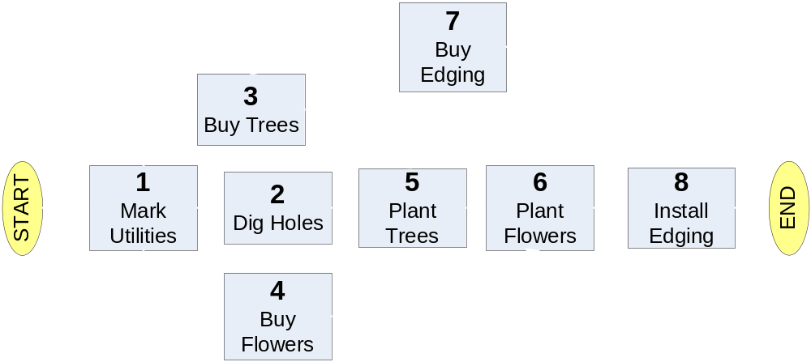
An Example of a Logical Sequence
Visual - Using a PERT Chart (Network Diagram)
Planting trees with flowers and edging around them
Visual – task relationships are clear – good snapshot

Slide 29
Variation in Networks
Standards such as BS 6046
Activity on Arrow
Activity on Node

Slide 30
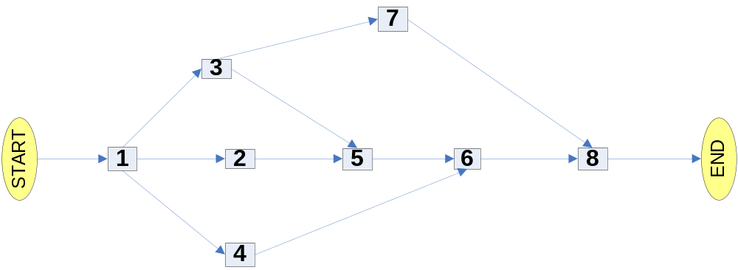

Slide 31
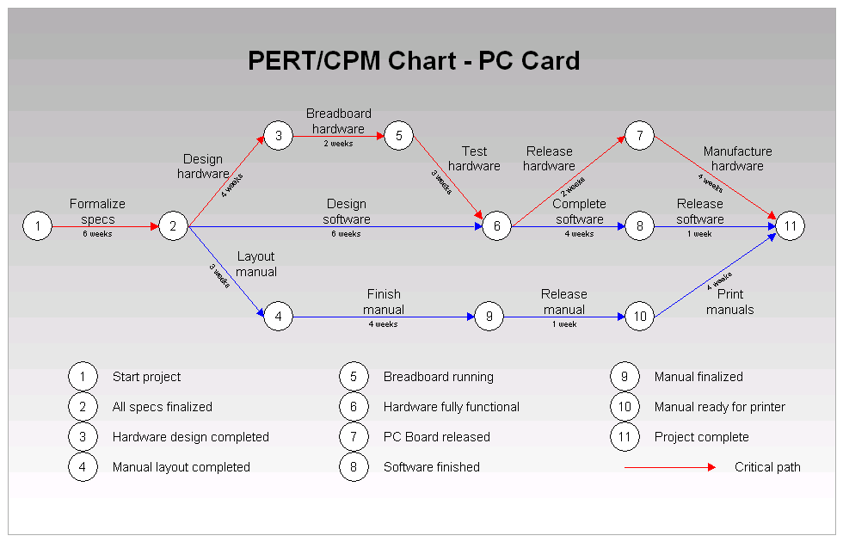

Slide 32
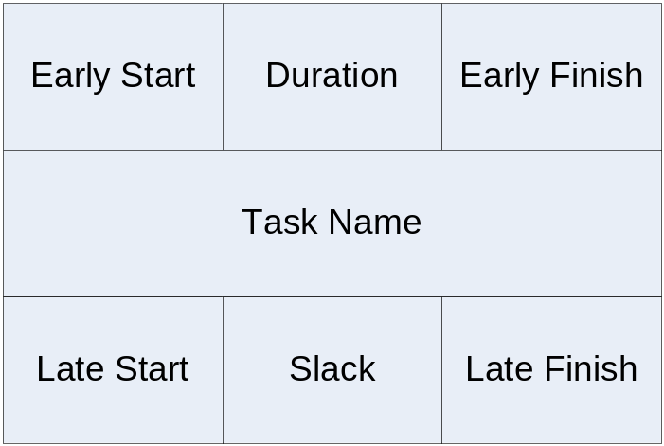
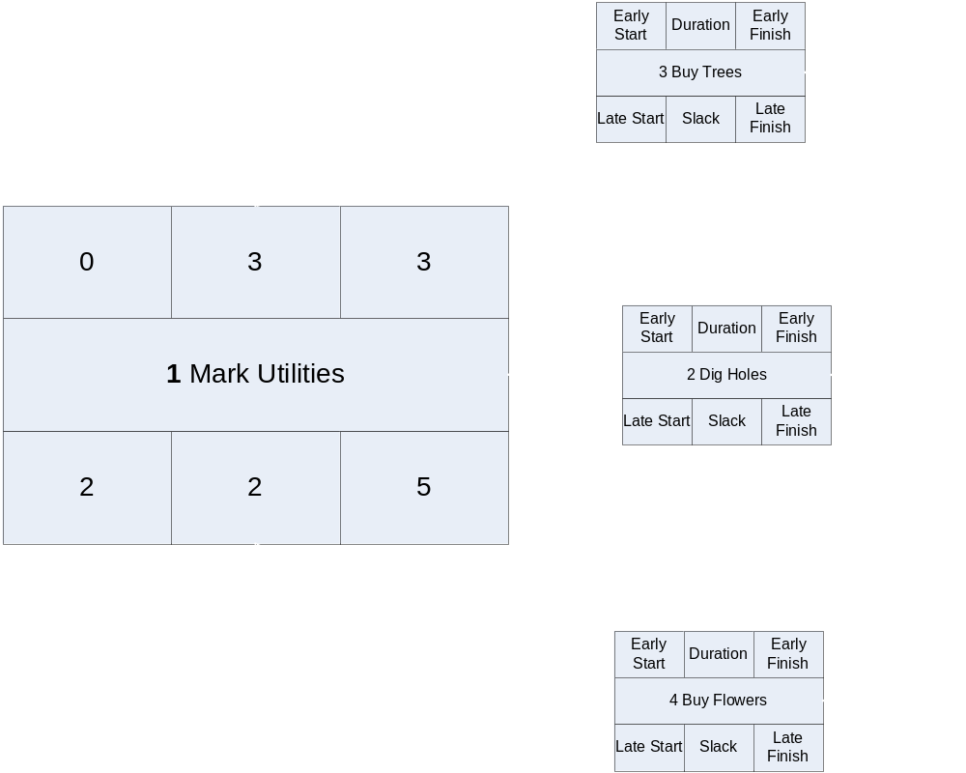

Slide 33
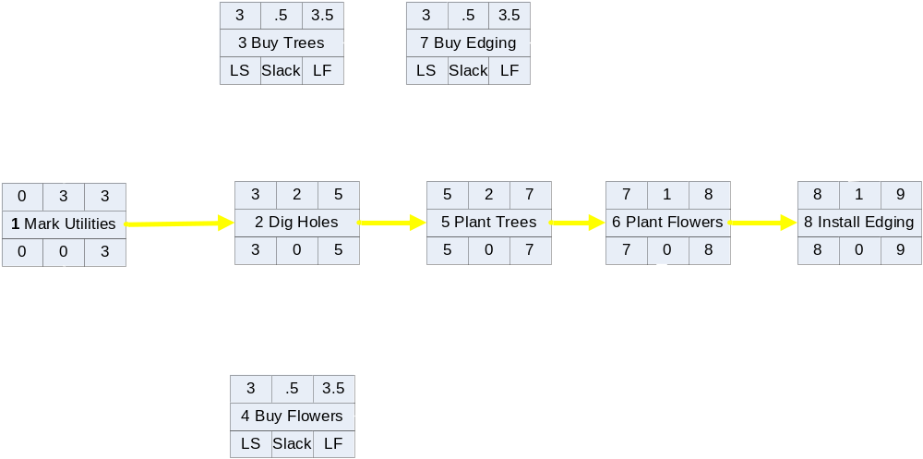

Slide 34
Forward and Backward Pass
Forward pass is a technique to move forward through a diagram to calculate activity duration. Backward pass is its opposite.
Early Start (ES) and Early Finish (EF) use the forward pass technique.
Late Start (LS) and Late Finish(LF) use the backward pass technique.
MEMORY TRIGGER: if the float of the activity is zero, the two starts (ES and LS) and the two finish (EF and LF) are the same. Hence, If float of activity is zero, ES = LS and EF = LF.

Slide 35
PM Today – Necessary?
Frustration with cost & schedule overruns
Frustration with reliability of production estimates
Management challenges exist today:
  Only 44% of projects are completed on time
  On average, projects are 189% over-budget
  70% of completed projects do not perform as expected
  30% of projects are canceled before completion
  On average, projects are 222% longer than expected
PM has been shown to improve this performance
These statistics were compiled by an independent monitoring group, The Standish Group, and represent the US national average for 1998

Slide 36
PERT/CPM CALCULATIONS
Basic Techniques

Slide 37
PERT Calculations
Step 1: Define tasks
Step 2: Place Tasks in a logical order, find the critical path
  The longest time path through the task network. The series of tasks (or even a single task) that dictates the calculated finish date
Step 3: Generate estimates
  Optimistic, pessimistic, likely and PERT- expected
  Standard Deviation and variance
Step 4: Determine earliest and latest dates
Step 5:Determine probability of meeting expected date
Steps 1 and 2 are logic and legwork, not calculation – these require a clear goal

Slide 38
PERT Calculations – Step 3
Assuming steps 1 and 2 have been completed begin calculations – use a table to organize your calculations
Simple calculations to estimate project durations
Based on input of 3 estimated durations per task
  Most Optimistic (T_{O}) – best case scenario
  Most Likely (T_{L}) “normal” scenario
  Most Pessimistic (T_{P}) Worst case scenario
Formula derives a probability-based expected duration (T_{E})
  (T_{O} x 1 + T_{L} x 4 + T_{P} x 1) / 6 = T_{E}
  Read this formula as the sum of (optimistic x 1 + likely x 4 + pessimistic x 1) divided by 6 = expected task duration
Complete this calculation for all tasks

Slide 39
PERT Calculations – Step 3
Standard deviation and variance
  Standard deviation (SD) is the average deviation from the estimated time
    SD=(T_{P}-T₀)/6 {read as (pessimistic-optimistic)/6}
    As a general rule, the higher the standard deviation the greater the amount of uncertainty
  Variance (V) reflects the spread of a value over a normal distribution
    V=SD² (Standard deviation squared)

Slide 40
PERT Calculations – Step 3
When doing manual PERT Calculations it is helpful to construct a table to stay organized
Consider the sample project– planting trees and flowers, set up using a list
  Rough estimates and no risk analysis
    No Range, simply rough estimates - unreliable?
  PERT Analysis will better refine estimates
Start by setting up a table to organize data

Slide 41
Our Project – A Refresher
TASK ID | Description | Duration (Days)
1 | Mark Utilities | ?
2 | Dig Holes | ?
3 | Buy Trees | ?
4 | Buy Flowers | ?
5 | Plant Trees | ?
6 | Plant Flowers | ?
7 | Buy Edging | ?
8 | Install Edging | ?
Set up in tabular form, it might look like this…
Set up in visual form it might look like this…

Slide 42
PERT Step 3– First Get Organized
In considering all tasks on the previous slide, a table might look like this
CRITICAL PATH TASKS (Longest Duration)
TASK | T_{O} | T_{L} | T_{P} | T_{E}
1
2
5
6
8
TOTAL
OTHER PROJECT TASKS
TASK | T_{O} | T_{L} | T_{P} | T_{E}
3
4
7
TOTAL
T_{O}-Optimistic T_{M}-Likely T_{P}-Pessimistic T_{E}-Expected (Derived by PERT)
Remember – tasks 3, 4 and 7 are concurrent and do not add to the timeline

Slide 43
PERT Step 3– Durations
After generating estimates using the formula, the table might look like this
CRITICAL PATH TASKS (Longest Duration)
TASK | T_{O} | T_{L} | T_{P} | T_{E} |  |  |  |  |  |  |  | SD | V
1 | 1 | 3 | 5 | 3 |  |  |  |  |  |  |  | .67 | .44
2 | 2 | 4 | 7 | 4.17 |  |  |  |  |  |  |  | .83 | .69
5 | 1 | 3 | 6 | 3.17 |  |  |  |  |  |  |  | .83 | .69
6 | 1 | 3 | 5 | 3 |  |  |  |  |  |  |  | .67 | .44
8 | 1 | 2 | 4 | 2.17 |  |  |  |  |  |  |  | .5 | .25
TOTAL | 7 | 15 | 28 | 15.6 |  |  |  |  |  |  |  | 3.5 | 2.51
OTHER PROJECT TASKS
TASK | T_{O} | T_{L} | T_{P} | T_{E} |  |  |  |  |  |  |  | SD | V
3 | .5 | 1 | 3 | 1.25 |  |  |  |  |  |  |  | .42 | .17
4 | .5 | 1 | 3 | 1.25 |  |  |  |  |  |  |  | .42 | .17
7 | .5 | 1 | 3 | 1.25 |  |  |  |  |  |  |  | .42 | .17
TOTAL | 1.5 | 3 | 9 | 3.75 |  |  |  |  |  |  |  | 1.26 | .51
T_{O}-Optimistic T_{M}-Likely T_{P}-Pessimistic T_{E}-Expected (Derived by PERT)
SD=Standard Deviation V=Variance

Slide 44
PERT Step 4 – Dates
For each task, determine the latest allowable time for moving to the next task
The difference between latest time and expected time is called slack time
Tasks with zero slack time are on the critical path
CRITICAL PATH TASKS (Longest Duration)
TASK | T_{O} | T_{L} | T_{P} | T_{E} |  | ES | EF | LS | LF |  |  | Slack | SD | V
1 | 1 | 3 | 5 | 3 |  | 0 | 3 | 0 | 3 |  |  | 0 | .67 | .444
2 | 2 | 4 | 7 | 4.17 |  | 3 | 7.17 | 3 | 7.17 |  |  | 0 | .83 | .694
5 | 1 | 3 | 6 | 3.17 |  | 7 | 10.17 | 7 | 10.17 |  |  | 0 | .83 | .694
6 | 1 | 3 | 5 | 3 |  | 10 | 13 | 10 | 13 |  |  | 0 | .67 | .444
8 | 1 | 2 | 4 | 2.17 |  | 13 | 15.17 | 13 | 15.17 |  |  | 0 | .5 | .254
TOTAL | 7 | 15 | 28 | 15.51 |  |  |  |  |  |  |  |  | 3.5 | 2.530
OTHER PROJECT TASKS
TASK | T_{O} | T_{L} | T_{P} | T_{E} | ES |  | EF | LS |  | LF | FLOAT |  | SD |  | V
3 | .5 | 1 | 3 | 1.25 | 0 |  | 1.25 | 3 |  | 4.25 | 3 |  | .42 |  | .17
4 | .5 | 1 | 3 | 1.25 | 0 |  | 1.25 | 3 |  | 4.25 | 3 |  | .42 |  | .17
7 | .5 | 1 | 3 | 1.25 | 1.25 |  | 2.50 | 4.25 |  | 5.50 | 3 |  | .42 |  | .17
TOTAL | 1.5 | 3 | 9 | 3.75 |  |  |  |  |  |  |  |  | 1.26 |  | .51
ES=Earliest Start EF= Earliest Finish LS=Latest Start LF=Latest Finish

Slide 45
PERT Step 5 – Probabilities
Manually computing probability using data compiled in your table
Determine probability of meeting a date by using the table data
  Denote the sum of all expected durations on the critical path as S
  Denote the sum of all variances on the critical path as V
  Select a desired completion time, denote this as D
  COMPUTE: (D-S)/square root (V) = Z ( the number of std. deviations that the due date is away from the expected date))
Enter a standard normal table to find a probability that corresponds with Z
For our project, figure a probability based on the most likely time, 15 days: (15-15.51)/square root(2.53) = (15-15.51)/1.59=-.3207 (Z)
A corresponding probability is 37.7% (Rounded)
This process can be repeated for any date desired

Slide 46
PERT Step 5 – Probabilities
Computing probability in Excel using data compiled in your table
Microsoft Excel has normal distribution functions built in and can compute PERT probabilities
By creating a table as a spreadsheet, the addition of a few simple formulae will do the rest of the work
Create a table as a template that can be used over and over again – simply change the input

